Slide 1
Making this resource work for you
Prior to teaching this lesson, please refer to the ‘Unit Overview and Planning Document’.
Further guidance on planning Science Mastery lessons can be found in the detailed planning guidance document.
Refer to the ‘notes’ section on each slide for useful information, including suggested expositions, pedagogical content knowledge, suggested questions, answers and more. Consider using presenter mode so you can see this guidance throughout the lesson.
The introduction slides can be adapted to suit your teaching style and the needs of your class.
Before the lesson, adapt the fix-it slide to address any misconceptions identified in the previous lesson’s exit ticket.
Choose from the suggested activities to suit your class. The intention is not that you complete all of these, but that you select those which ones are most appropriate for your students. It may be appropriate to further adapt activities for your students.
These lessons are designed to occupy approximately 1 hour. To adapt for a shorter or longer lesson duration we advise you to adapt the activity section accordingly.
Please consider using the final slide to send feedback about this lesson or examples of PowerPoints that you have adapted to our design team. Your feedback is used to improve Science Mastery for all of our teachers and students. We appreciate all suggestions and comments.
Thank you for reading!
The Science Mastery Team

Slide 2

Electrolysis of Molten Ionic Compounds
Answer the questions below.
State the name of the two electrodes in an electrolysis set-up.
State the charge on these electrodes.
Give one industrial use of electrolysis.
Aluminium oxide, Al₂O₃, is an ore of aluminium. Calculate the relative formula mass of aluminium oxide.
State the formula for an aluminium ion.
Anode, cathode
An anode has a positive charge, and a cathode has a negative charge.
Electrolysis is used to produce oxygen for diving tanks.
102
Al³⁺
Notes:
Big idea: Reactions Rearrange Matter
Foundation: State the formula for an oxide ion.
Stretch: (HT) Write a half equation to show this oxide ion being reduced to form oxygen gas.
Answers:
Foundation: O²⁻
Stretch: 2O²⁻ → O₂ + 2e⁻

Slide 3
Electrolysis of Molten Ionic Compounds
Do Now:
State the name of the two electrodes in an electrolysis set-up.
State the charge on these electrodes.
Give one industrial use of electrolysis.
Aluminium oxide, Al₂O₃, is an ore of aluminium. Calculate the relative formula mass of aluminium oxide.
State the formula for an aluminium ion.
Drill:
State the formula for an oxide ion.
Which electrode would an oxide ion be attracted to?
State the formula for a hydrogen ion.
What type of substance always contains hydrogen ions?
Notes:
Answers:
Do Now:
1. Anode, cathode
2. An anode has a positive charge and a cathode has a negative charge.
3. Electrolysis is used to produce oxygen for diving tanks.
4. 102
5. Al³⁺
Drill:
1. O²⁻
2. Anode
3. H⁺
4. Acids

Slide 4
Electrolysis of Molten Ionic Compounds
Read Now:
Many companies are busy coming up with new ideas to help us move to a more sustainable future. One way of doing this would be by using electric cars and motorcycles instead of transport fuelled by fossil fuels. In Argentina, a student called Santiago Hernandez had an idea when he was studying the topic of electrolysis. He wondered if it could be used to propel a vehicle. Now, he has invented an electric motor which runs on salt water, with no other fuel needed. The design will need more modifications before it will produce enough electricity for full-size vehicles.
State one change that we could make to our lifestyles towards a more sustainable future.
Where is Santiago Hernandez from?
What did Santiago think that electrolysis could be used for?
What does Santiago's motor need to work?
Why isn't Santiago's motor ready to use in cars now?
Notes:
Answers:
1. We could use more electric vehicles and less vehicles powered by fossil fuels
2. Santiago Hernandez is from Argentina
3. Santiago thought that electrolysis could be used to propel a vehicle
4. Santiago's motor only needs salt water to work
5. Santiago's motor is not ready to use in cars yet because it doesn't yet produce enough electricity

Slide 5

C4.2.9
17/11/2025
Electrolysis of Molten Ionic Compounds
C4.2.1 PKR: Reactivity of Metals
C4.2.2 Extracting Less Reactive Metals
C4.2.3 PKR: Ions, Ionic Bonding and Deducing Ionic Formulae
C4.2.4 (HT) Ionic Equations and Displacement Reactions
C4.2.5 (HT) Writing Half Equations
C4.2.6 (HT) Ionic Equations for the Reactions of Acids and Metals
C4.2.7 Introduction to Electrolysis
C4.2.8 Extracting Metals by Electrolysis
C4.2.9 Electrolysis of Molten Ionic Compounds
C4.2.10 Electrolysis in Solutions
C4.2.11RP: Electrolysis of Aqueous Solutions 1
C4.1.12 RP: Electrolysis of Aqueous Solutions 2
C4.1.13 TIF: Corrosion and its Prevention
C4.2.14 (HT) Obtaining Raw Materials
C4.2.15 Recycling Metals
C4.2.16 Feedback Lesson
Notes:
Big Idea: Reactions Rearrange Matter

Slide 6

Following this lesson, students will be able to:
Recall that during electrolysis, ions are discharged at the electrodes forming elements
Predict the ions discharged at each electrode
(HT) Write half equations to describe the discharge of ions at each electrode
Key Words:
discharged
anode
cathode
electrolysis
electrolyte
Notes:
Guidance:
See unit overview document and planning guidance to see how these objectives are typically assessed at GCSE, including examples of what students should be able to do following this lesson.
Planning for different needs:
The learning objectives given on this slide are suggested based on the most common requirements for exams, however they can be adapted based on the needs of different classes.
For best practice, the unit preparation booklet should be used to determine the appropriate focus of lessons within the unit.
While it is not possible to explicitly split content into levelled grades, we recommend that lesson objectives can be classified as critical, core or stretch.
Critical: the content or skill is essential for all students to be able to progress.
Core: the content or skill is important for students to progress, but other opportunities may be available to revisit it.
Stretch: the content or skill may not be essential for all students but is important for students aiming for the highest grades.
Key skill: this is a crucial skill being developed in this unit as part of the skill mapping
C4.2.9 Lesson Objectives:
Core: Recall that during electrolysis, ions are discharged at the electrodes forming elements
Core: Predict the ions discharged at each electrode
Stretch: (HT) Write half equations to describe the discharge of ions at each electrode

Slide 7
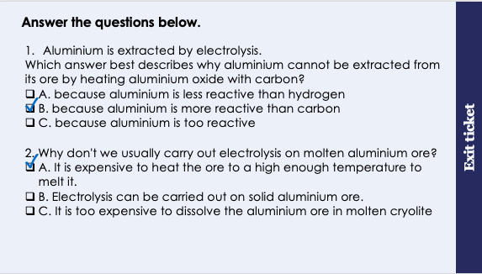
This is the fix-it portion of the lesson
The fix-it is an opportunity to respond to gaps in knowledge, especially those identified by the previous lesson’s exit ticket.
The teacher should customise this slide as needed, to facilitate
reteach, explanation, demonstration or modelling of ideas and concepts that students have not yet grasped or have misunderstood.
practise answering specific questions or of key skills.
redrafting or improving previous work.
Notes:
Fix-it guidance from previous exit ticket:
Q1. Answer: B
If students answer A or C, they have either not consulted the reactivity series, or have misinterpreted it to think that aluminium is less reactive than hydrogen. They may also have the misconception that reactive metals cannot be extracted. To fix-it, use the reactivity series to recap the different methods of extraction of metals, and when each one is suitable, by referring to their relative reactivities compared to hydrogen and carbon.
Q2. Answer: A
If students answer B, they have the misconception that electrolysis can be carried out with a solid electrolyte. To fix-it, use a diagram of an ionic lattice or solid particle diagram to explain why solid ionic substances or solid aluminium ore cannot conduct electricity.
If students answer C, they have grasped that carrying out electrolysis on molten aluminium ore is expensive, but they have not understood why this is so. To fix it, point out that dissolving is not an expensive process, but the energy required to heat an ore to melt it is expensive.

Slide 8
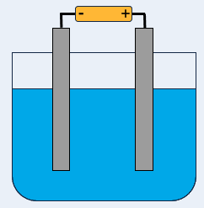
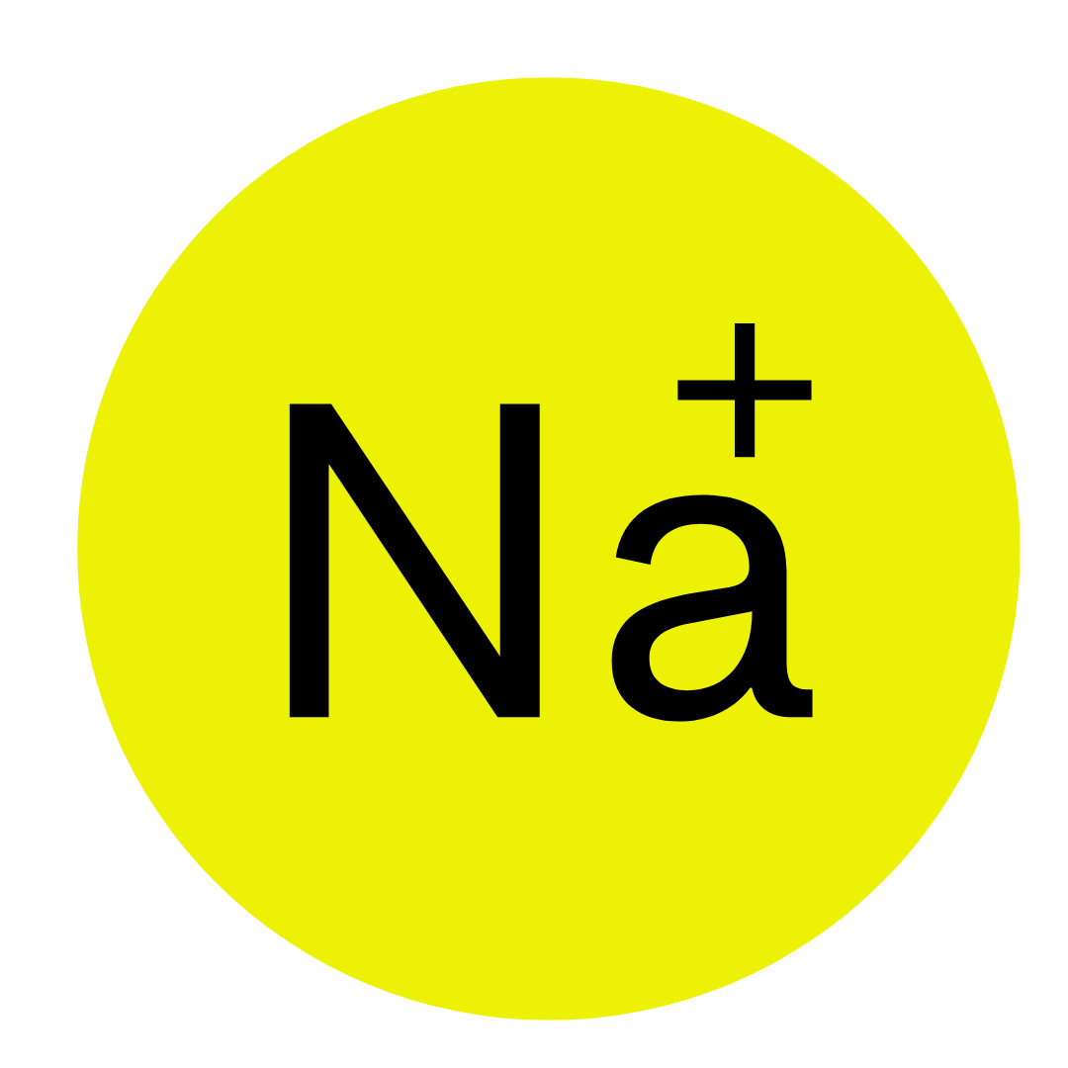
What happens to a positive ion in the electrolyte?
Let’s take the example of molten sodium chloride.
Sodium chloride contains one positive ion (cation): Na⁺.
When the current Is switched on, the positive ion moves towards the negative electrode (cathode)
2. At the cathode, the cation is discharged (turns from an ion to an element)
3. The metal is observed to form at the cathode
Higher Tier only
This can be summarised with a half equation:
Na⁺_{(l)} + e⁻ → Na_{(s)}
Notes:
Model teacher exposition:
Last lesson we looked at the electrolysis of aluminium oxide. All ionic compounds can be electrolysed when they are molten and for this lesson we will look at what happens when different molten ionic compounds are electrolysed. What does molten mean? Melted/liquid.
Let’s take the example of molten sodium chloride. It is an ionic compound that contains a positively charged cation and a negatively charged anion. What is the cation in NaCl? Na+
So, the cation is Na+ and to which electrode will it move? The negatively charged electrode/the cathode.
When the current Is switched on, the positive ion moves towards the negative electrode (cathode) shown in this animation.
At the cathode, the cation is discharged. This means it is reduced by gaining an electron and becomes an element. So there are sodium atoms produced as a result of the Na+ ions being discharged.
The Na metal will be observable at the cathode and you would see a shiny, silver solid metal.
(HT only) this can be shown by this half equation

Slide 9
Complete the table.
Electrolyte name | Ions in the electrolyte | Ion discharged at the cathode | What would be observed at the cathode? | (HT only) Half equation at the cathode
Molten lithium fluoride
Molten potassium chloride
Li⁺
F⁻
Lithium metal would form
Li⁺
Na⁺ + e⁻ → Na
K⁺
Cl⁻
Potassium metal would form
K⁺
K⁺ + e⁻ → K
PANIC
Positive Anode Negative Is Cathode

Slide 10

What happens to a negative ion in the electrolyte?
Let’s take the example of molten sodium chloride.
Sodium chloride contains one negative ion (anion): Cl⁻.
When the current Is switched on, the negative ion moves towards the positive electrode (anode)
2. At the anode, the anion is discharged (turns from an ion to an element)
3. The non-metal is observed to form at the cathode
Higher Tier only
This can be summarised with a half equation:
2Cl⁻_{(aq)} → Cl_{2(g)} + 2e⁻
Notes:
Model teacher exposition:
Using the same example of molten sodium chloride, what is the negatively charged anion in NaCl? Cl-
So the anion is Cl- and to which electrode will it move? The positively charged electrode/the anode.
When the current Is switched on, the negative ion moves towards the positive electrode (anode) shown in this animation.
At the anode, the anion is discharged. This means it is oxidised by losing an electron and becomes an element. So there are chlorine atoms produced as a result of the Cl- ions being discharged.
The Cl will be observable at the anode and you would see a green/yellow gas formed
(HT only) this can be shown by this half equation

Slide 11
Complete the table.
Electrolyte name | Ions in the electrolyte | Ion discharged at the anode | What would be observed at the anode? | (HT only) Half equation at the cathode
Molten lithium fluoride
Molten potassium chloride
Bubbles of fluorine gas would form.
Li⁺
F⁻
F⁻
2F⁻ → F₂ + 2e⁻
Bubbles of chlorine gas would form
K⁺
Cl⁻
Cl⁻
2Cl⁻ → Cl₂ + 2e⁻
PANIC
Positive Anode Negative Is Cathode

Slide 12
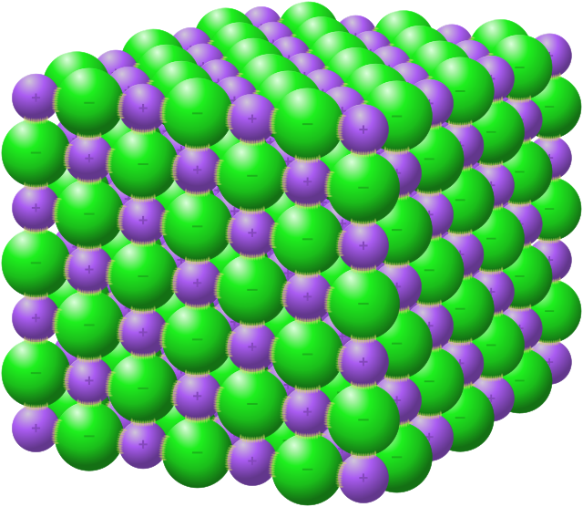
This is an ionic compound.
Discuss why electrolysis will not work on this substance.
What could a scientist do to so that electrolysis could be carried out with this substance?
Notes:
Suggested guidance:
Talk tasks can be used in a variety of ways to suit the particular needs of the students you are teaching. Through exchanging views with others, students develop their understanding of the science beyond what could be achieved individually.
Science classrooms that successfully integrate talk have the following features:
Science talk is a regular feature of lessons and is woven into classroom activities.
Students are paired or grouped strategically by the teacher to ensure productive interaction. This might take into consideration the students’ proficiency of the English language, how encouraging they might be to peers and their attainment in the topic. It’s a good idea to consider these pairings in the class seating plan.
Students are encouraged and supported to talk, but are not forced to talk.
The teacher should take on the role of a facilitator, engaging with conversations where necessary and encouraging or steering the conversation where needed.
Students are encouraged to use the language they have to express their ideas (e.g., everyday language, imperfect English, native language), but also to incorporate science specific terminology where this is more accurate or has been taught.
6. Scientifically inaccurate ideas are not dismissed by the partner or teacher; open discussion and further investigation are relied on to help students construct ideas that support them to progress in their scientific understanding.
7. Guidelines for behaviour during talk tasks are explicit and frequently reviewed. Rules for students might be:
Listen carefully to your partner
Take turns talking.
Speak one at a time, without interrupting.
Politely agree or disagree and explain why.
Politely point out if your partner has used a scientific word incorrectly, if they have explained the science incorrectly, or if there is a more accurate way to describe something.
If confused, ask questions.
Stay focused on the discussion topic.
Respond to one another.

Slide 13
Drill
What is a cation?
What is an anion?
Name the positive ion present in molten lithium chloride.
Name the negative ion present in molten beryllium oxide.
What is produced when a positive ion is discharged at an electrode?
What is produced when a negative ion is discharged at an electrode?
What is observed when a chloride ion is discharged?
At which electrode will a positive ion be discharged?
At which electrode will a negative ion be discharged?
(HT only) Write a half equation to represent the discharge of a sodium ion (Na⁺)
Notes:
Purpose: This is a knowledge drill. The purpose of this is to check that the critical knowledge is secure before pupils move onto independent practice.
Suggested guidance: There are a range of ways this could be done depending on time and ability range of the class:
Mini whiteboards
As full sentences in exercise books
As short answers in exercise books
In the pupil workbook
As pair talk
As cold call

Slide 14
Drill answers
A cation is a positively charged ion
An anion is a negatively charged ion
The positive ion in molten lithium chloride is Li⁺
The negative ion in molten beryllium oxide is O²⁻
When a positive ion is discharged at an electrode, a metal is produced
When a negative ion is discharged at an electrode, a non-metal is produced
When a chloride ion is discharged, chlorine gas is produced
A positive ion will be discharged at the the negative electrode (cathode)
A negative ion will be discharged at the positive electrode (anode)
Na⁺ + e⁻ → Na
Notes:
Purpose: This is a knowledge drill. The purpose of this is to check that the critical knowledge is secure before pupils move onto independent practice.
Suggested guidance: There are a range of ways this could be done depending on time and ability range of the class:
Mini whiteboards
As full sentences in exercise books
As short answers in exercise books
In the pupil workbook
As pair talk
As cold call

Slide 15
I: Describing what happens at each electrode
A scientist carried out the electrolysis of molten lithium fluoride.
Describe what will occur at each electrode.
HT only – Write half equations to describe the discharge of ions at each electrode
At the anode (positive electrode)
Fluoride ions (F⁻) will move towards the anode
Here, the ions will be discharged
They will lose electrons. This is called oxidation.
To form fluorine gas
Bubbles of fluorine gas will be observed.
At the cathode (negative electrode)
Lithium ions (Li⁺) will move towards the cathode
Here, the ions will be discharged
They will gain electrons. This is called reduction.
To form lithium metal
Lithium metal will be observed forming
(b) 2F⁻ → F₂ + 2e⁻ Li⁺ + e⁻ → Li
Notes:
Purpose: The I-We-You section aims to support pupils to build skills that they most commonly need when answering questions associated with this knowledge in the assessment. This section is also used to interleave other content we expect pupils to know at this stage of their education in order that they build a big picture of the science they are learning.
For the ‘I’ activity, the teacher should model how to answer the question. They can do this by narrating their thinking process aloud, and making links to learning earlier in the lesson explicit.
For the ‘we’ activity, the teacher and students work though a similar example together, in order to prepare students to be able to answer a similar question independently.
Opportunities for the ‘you’ activity – independent practise – occur in the activity portion of the lesson once the student is secure enough to process independently.

Slide 16
We: Describing what happens at each electrode
A scientist carried out the electrolysis of molten sodium chloride.
Describe what will occur at each electrode.
HT only – Write half equations to describe the discharge of ions at each electrode
At the anode (positive electrode)
Chloride ions (Cl⁻) will move towards the anode
Here, the ions will be discharged
They will lose electrons. This is called oxidation.
To form chlorine gas
Bubbles of chlorine gas will be observed.
At the cathode (negative electrode)
Sodium ions (Na⁺) will move towards the cathode
Here, the ions will be discharged
They will gain electrons. This is called reduction.
To form sodium metal
Sodium metal will be observed forming
(b) 2Cl⁻ → Cl₂ + 2e⁻ Na⁺ + e⁻ → Na
Notes:
Purpose: The I-We-You section aims to support pupils to build skills that they most commonly need when answering questions associated with this knowledge in the assessment. This section is also used to interleave other content we expect pupils to know at this stage of their education in order that they build a big picture of the science they are learning.
For the ‘I’ activity, the teacher should model how to answer the question. They can do this by narrating their thinking process aloud, and making links to learning earlier in the lesson explicit.
For the ‘we’ activity, the teacher and students work though a similar example together, in order to prepare students to be able to answer a similar question independently.
Opportunities for the ‘you’ activity – independent practise – occur in the activity portion of the lesson once the student is secure enough to process independently.

Slide 17
You: Describing what happens at each electrode
A scientist carried out the electrolysis of molten potassium bromide.
Describe what will occur at each electrode.
HT only – Write half equations to describe the discharge of ions at each electrode
At the anode (positive electrode)
Bromide ions (Br⁻) will move towards the anode
Here, the ions will be discharged
They will lose electrons. This is called oxidation.
To form bromine
Bromine will be observed (a brown red liquid).
At the cathode (negative electrode)
Potassium ions (K⁺) will move towards the cathode
Here, the ions will be discharged
They will gain electrons. This is called reduction.
To form potassium metal
Potassium metal will be observed forming
(b) 2Br⁻ → Br₂ + 2e⁻ K⁺ + e⁻ → K
Notes:
Purpose: The I-We-You section aims to support pupils to build skills that they most commonly need when answering questions associated with this knowledge in the assessment. This section is also used to interleave other content we expect pupils to know at this stage of their education in order that they build a big picture of the science they are learning.
For the ‘I’ activity, the teacher should model how to answer the question. They can do this by narrating their thinking process aloud, and making links to learning earlier in the lesson explicit.
For the ‘we’ activity, the teacher and students work though a similar example together, in order to prepare students to be able to answer a similar question independently.
Opportunities for the ‘you’ activity – independent practise – occur in the activity portion of the lesson once the student is secure enough to process independently.

Slide 18
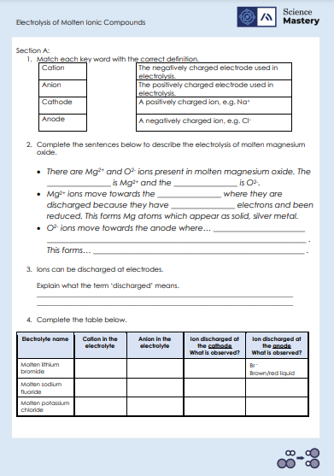
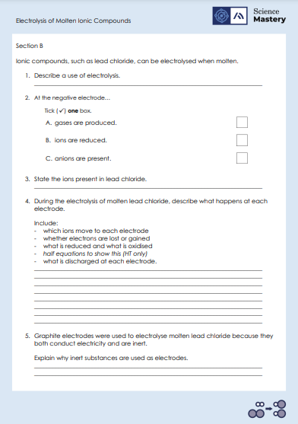
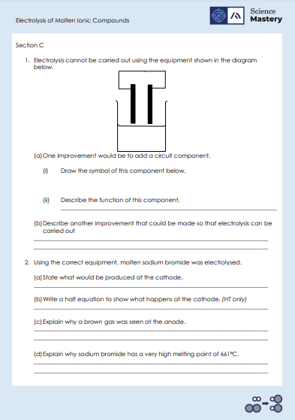
Activity

Slide 19
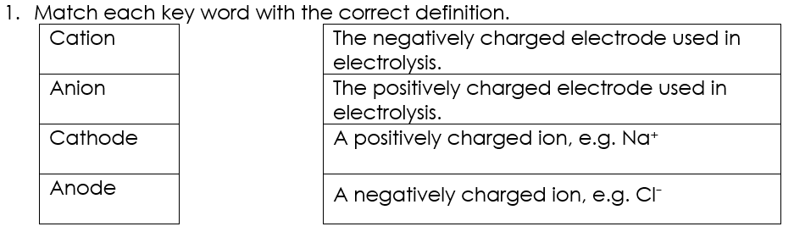
Answers – Section A

Slide 20
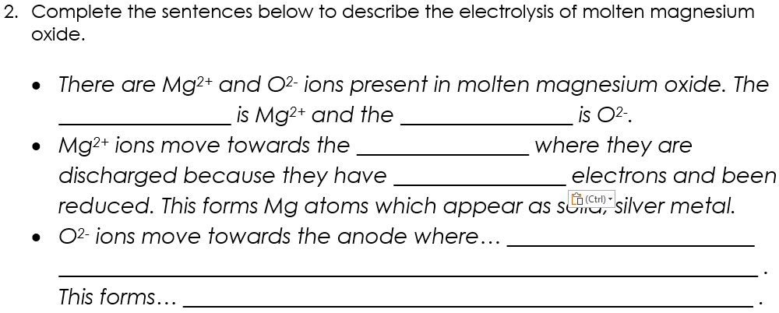
Answers – Section A
cation
anion
cathode
gained
they are discharged
because they have lost electrons and been oxidised.
O atoms which appear as bubbles of transparent gas.

Slide 21
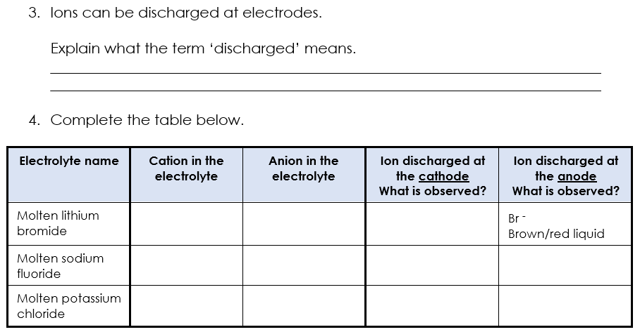
Answers – Section A
When ions gain or lose electrons to form neutral atoms or molecules.
Br⁻
Li⁺ Solid, shiny, silver metal
Li⁺
F⁻
Na⁺ Solid, shiny, silver metal
F⁻
Yellow gas
Na⁺
Cl⁻
K⁺ Solid, shiny, silver metal
Cl⁻
Green gas
K⁺

Slide 22
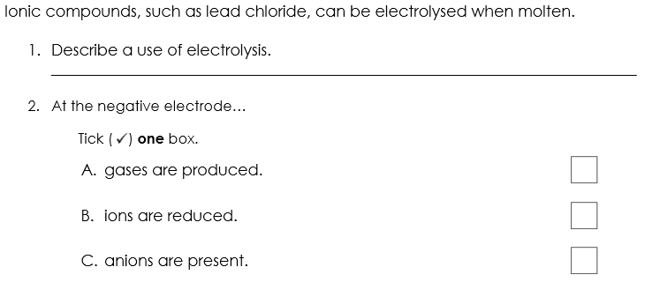
Answers – Section B
To extract metals from their ore when they are more reactive than carbon.
✓

Slide 23
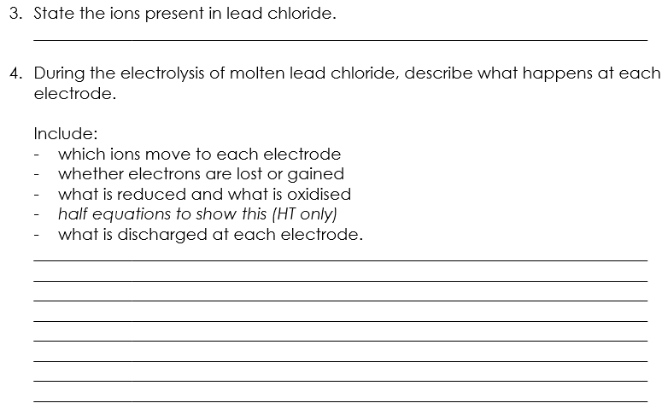
Answers – Section B
Pb²⁺ Cl⁻
Lead ions (Pb²⁺) will move towards the cathode and will be discharged because they gain electrons. This is called reduction.
Lead metal will be observed forming
Pb²⁺ + 2e⁻ → Pb
Chloride ions (Cl⁻) will move towards the anode and will be discharged because they lose electrons. This is called oxidation.
Bubbles of chlorine gas will be observed.
2Cl⁻ → Cl₂ + 2e⁻

Slide 24
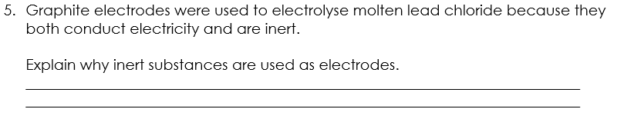
Answers – Section B
Inert substances are very unreactive so they wont react with ions in the electrolyte and take part in unwanted reactions.

Slide 25
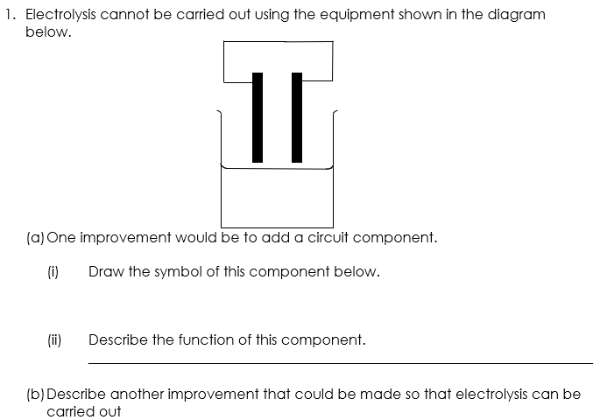
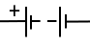
Answers – Section C
If not in contact with electrolyte, then current cannot flow
Place electrodes in the electrolyte
Generates a current to flow through the electrolyte​/circuit
Notes:
Suggested guidance: working through these with the class at the white board whilst questioning about each part of the calculations will support students who are struggling with these different types of calculations.
Suggested guidance: Q2 has been rounded to the nearest whole number but decimal values are acceptable too.

Slide 26
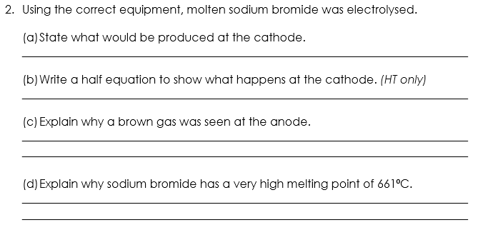
Answers – Section C
Sodium atom/element/metal
Na⁺ + e⁻ → Na
Bromine gas is produced at the anode because bromide ions are oxidised and discharged there.
Sodium bromide has a giant ionic lattice structure where there are many strong bonds of electrostatic attraction between ions. Therefore a great amount of energy is required to break these bonds to melt the solid into a liquid.
Notes:
Suggested guidance: working through these with the class at the white board whilst questioning about each part of the calculations will support students who are struggling with these different types of calculations.
Suggested guidance: Q2 has been rounded to the nearest whole number but decimal values are acceptable too.

Slide 27
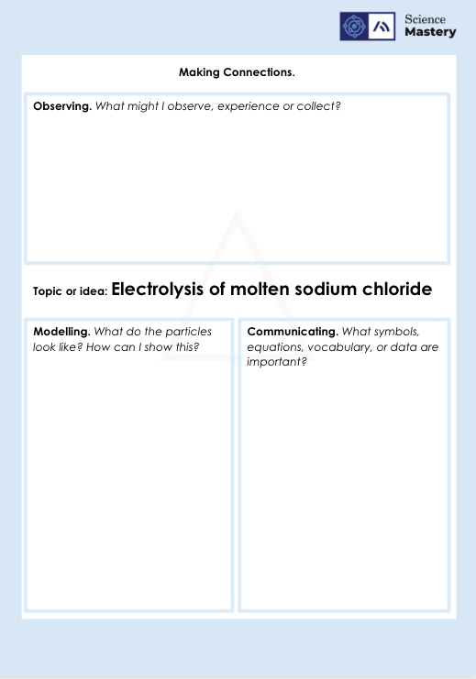
Electrolysis triangle activity

Slide 28
Answer the questions below.
Sodium ions move to the negative electrode. Choose the best explanation for this.
A. Sodium electrons are negative so they are attracted to the negative electrode
B. Sodium ions are positive so they are attracted to the negative electrode
C. Sodium ions are negative and are attracted to the negative electrode
✓
2. Molten lead bromide was electrolysed using inert electrodes. Choose what was produced at the positive electrode (anode).
A. Bromine
B. Bromide ions
C. Lead
D. Lead ions
✓
Notes:
Q1. Answer: B
If students answer A, they made the mistake of thinking that sodium ions are negatively charged. To fix-it, ask students to draw the electronic configuration of a sodium atom. Discuss how these atoms lose electrons (just as other metal atoms do), and that this causes them to be positively charged.
If students answer C, they have made the mistake of thinking that a negative ion is attracted to the negative electrode. To fix-it, remind students that anions are attracted to the anode and cations are attracted to the cathode.
Q2. Answer: A
If students answer B or D, they have not grasped that ions are not produced at the electrodes. To fix-it, remind students that ions are attracted to the electrodes, but that neutral atoms are produced there.
If students answer C or C, they think that an ion with a positive charge will move to the positive electrode. To fix-it, remind students that anions are attracted to the anode and cations are attracted to the cathode.

Slide 29
Answer the question below.
3. Choose the correct statement.
A. Negative ions gain electrons from the positively charged cathode
B. Positive ions gain electrons from the negatively charged cathode
C. Negative ions lose electrons at the negatively charged cathode
✓
Notes:
Q3. Answer: B
If students answer A, they think that negative ions will lose electrons.
If students answer C, they think that negative ions move to the negative electrode.
To fix-it, use a diagram to annotate the process of electrolysis, showing the movement of different ions towards the electrodes, and where ions are gained or lost.

Slide 30
Lesson C4.2.9
What was good about this lesson? | What can we do to improve this lesson?
Send us your feedback by clicking this link
or by emailing sciencemastery@arkonline.org
Thank you!

